Slide 1
A Picture (Of Data) Is Worth a Thousand Words
William Blueher, Metadata & Collections Librarian, Thomas J. Watson Library
Michael Cummings, Systems Librarian, Thomas J. Watson Library
Notes:
The Metropolitan Museum of Art is situated on the Lenape island of Manhahtaan in Lenapehoking, the Lenape homeland.

Slide 2
Library Dashboard Motivation and Benefits
Video capture: Staff version of the Library Dashboard
Notes:
This discussion is an extension of the poster presentation of the same title from the previous ARLIS conference. This slide is a video capture of the staff version of the Library Dashboard.

Slide 3
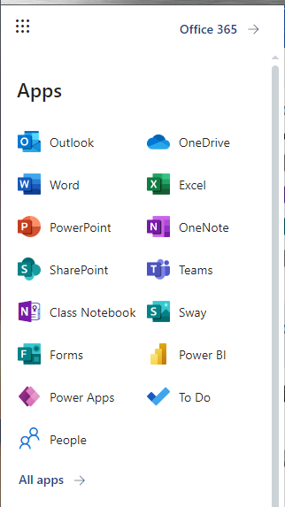
Why PowerBI? Criteria
The Met has an Enterprise License. PowerBI is used by other departments.
PowerBI is endorsed by IT department.
No additional cost per user.
Training was provided. Documentation is readily available.
PowerBI provides features that are comparable to other products.
Microsoft Apps Menu
Notes:
The rationale for using PowerBI: license; endorsed; no cost; training and documentation; features.

Slide 4
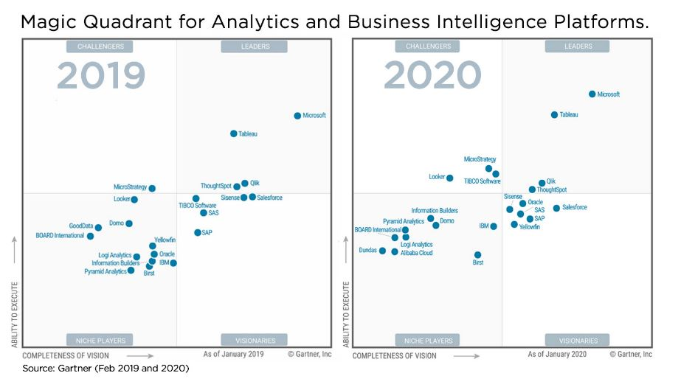
Why PowerBI? Industry Leader
Challengers
Leaders
Challengers
Leaders
Niche Players
Visionaries
Niche Players
Visionaries
Notes:
We had experience with other tools like R Studio, D3, and Tableau. But given the criteria previously cited and the fact that PowerBI consistently out ranked other products
year after year, we felt PowerBI was our best option.

Slide 5
Numbers Are Fun, Sort Of
My library has a million books!!!
Notes:
No context. 3-part story: part 1

Slide 6
Numbers Are Fun, Sort Of
I mean yeah, it’s pretty awesome, but we used to have 10 million.
Notes:
3-part story: part 2

Slide 7
Numbers Are Fun, Sort Of
Yeah it is, especially because 10 years ago we only had 50,000!!
Notes:
3-part story: part 3

Slide 8
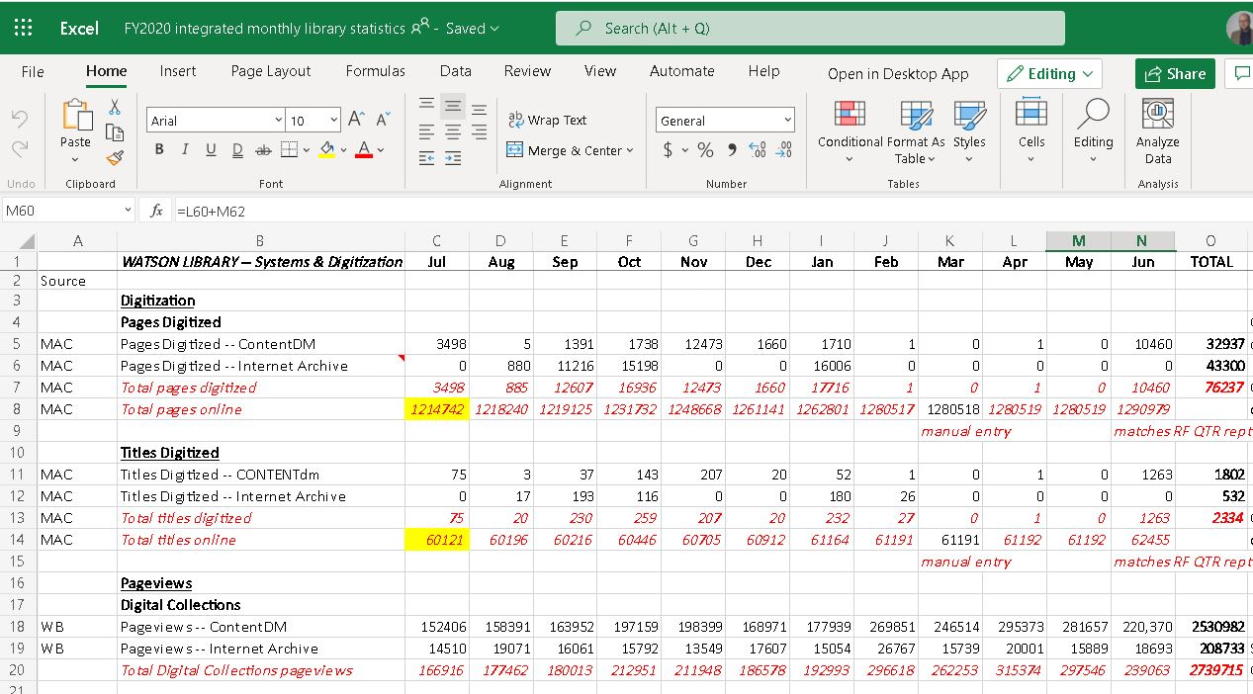
The Data We’ve Got
Notes:
PowerBI allows us to take these decontextualized numbers and turn them into something you might actually want to interact with – we can turn them into something that resembles a story. Slide show a part of our spreadsheet “FY2020 integrated monthly library statistics” where staff input data from multiple sources including Sierra ILS, google analytics, ContentDM, e-Resource vendors, etc.

Slide 9
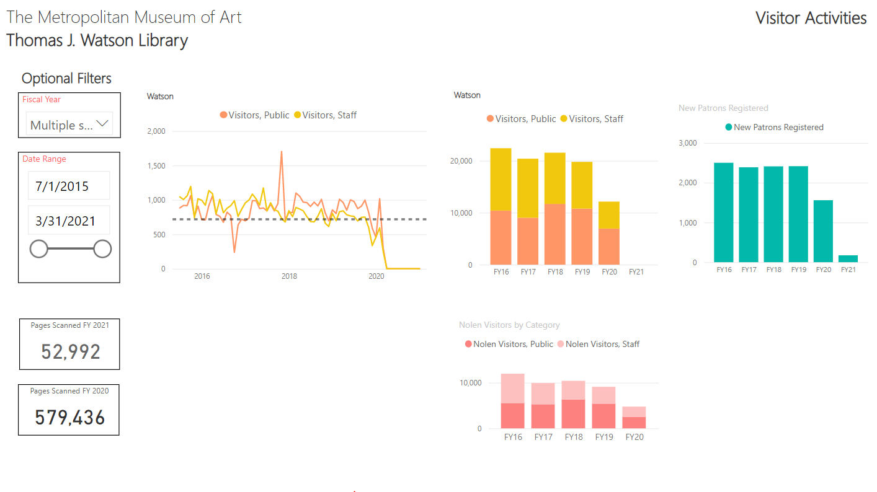
Contextualizing That Data
Notes:
Giving you a glimpse into our staff-only dashboard

Slide 10
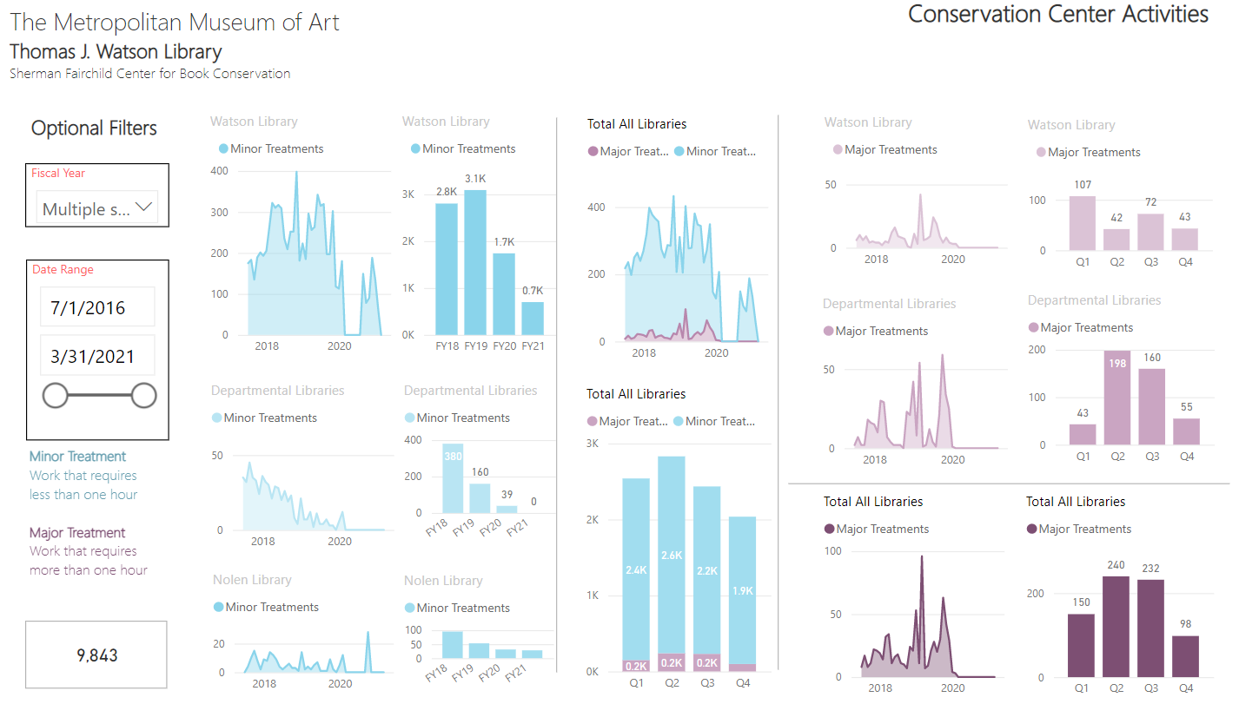
Hope Springs Eternal
Notes:
These numbers tell you the obvious: that something catastrophic happened in March of 2020, but they can also be serve as helpful guides for the future, letting you know where you once were, thus allowing you to plan for how you may be able to get back there one day

Slide 11
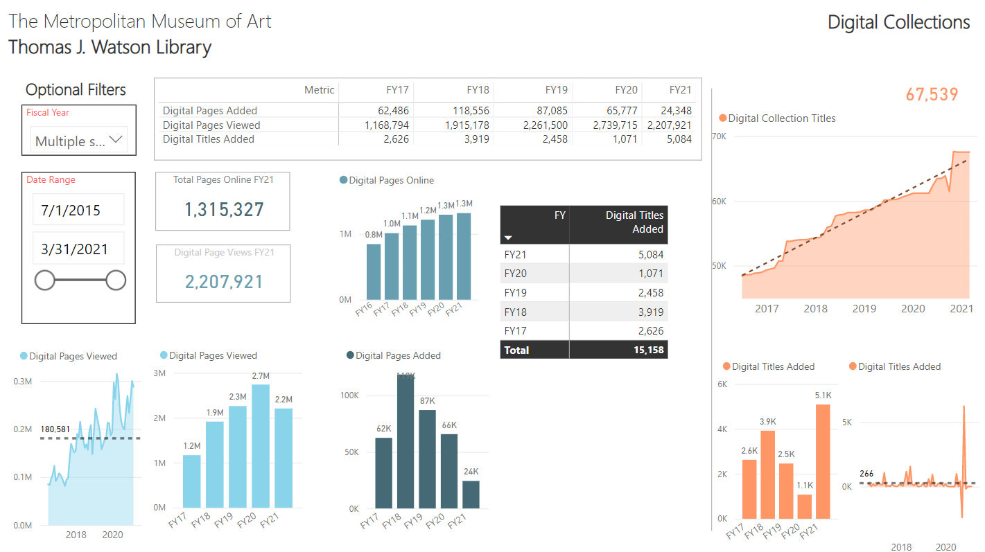
Digital Saves the Day
Notes:
More stories. Digital Collections.

Slide 12
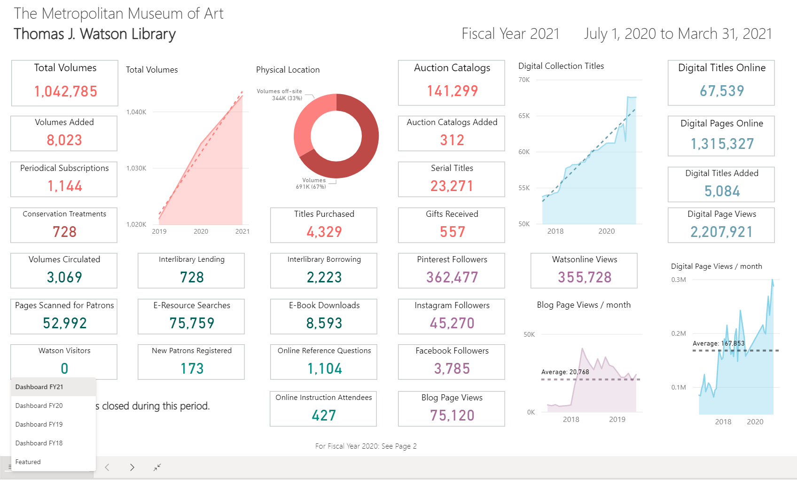
Public Dashboard: A Live Demo of the Public Dashboard
https://www.metmuseum.org/art/libraries-and-research-centers/thomas-j-watson-library/dashboard
Notes:
Screenshot of the public dashboard which is published on the Museum web site.

Slide 13
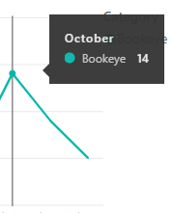
Emphasis: Interactivity
Video capture: Library Systems Help Desk dashboard
Notes:
An advantage of dashboards is the ability to provide the user with engaging interactive filters. The visual elements also interact with each other. This slide shows a screen shot from an early version of a report we did for the Library Systems department, our first dashboard. This is a short video clip.

Slide 14
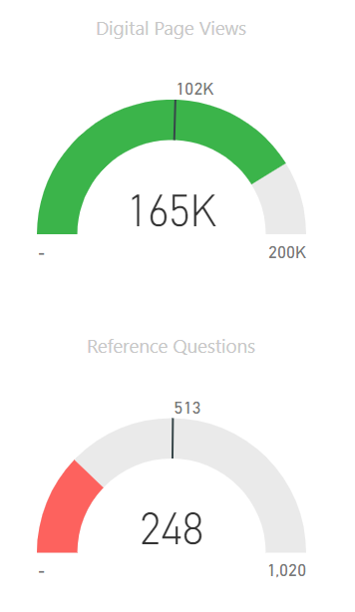
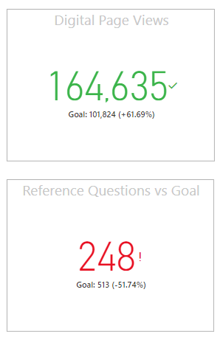
More visualization options Gauges / KPI’s / Year Over Year
Notes:
We decided to display trend lines like average per month and focus on change over time. However, PowerBI does provide various options to display key performance indicators like these gauges, status cards, and tables.

Slide 15
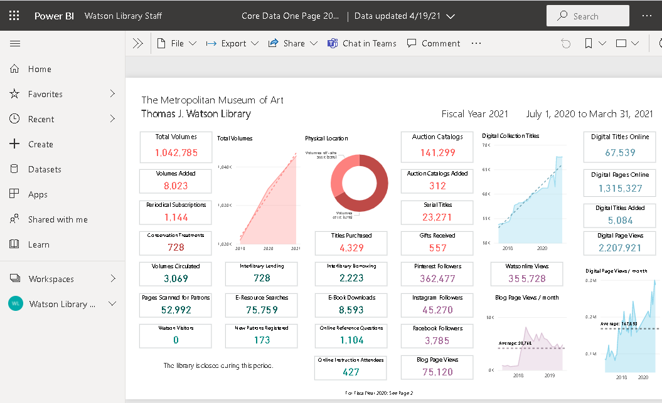
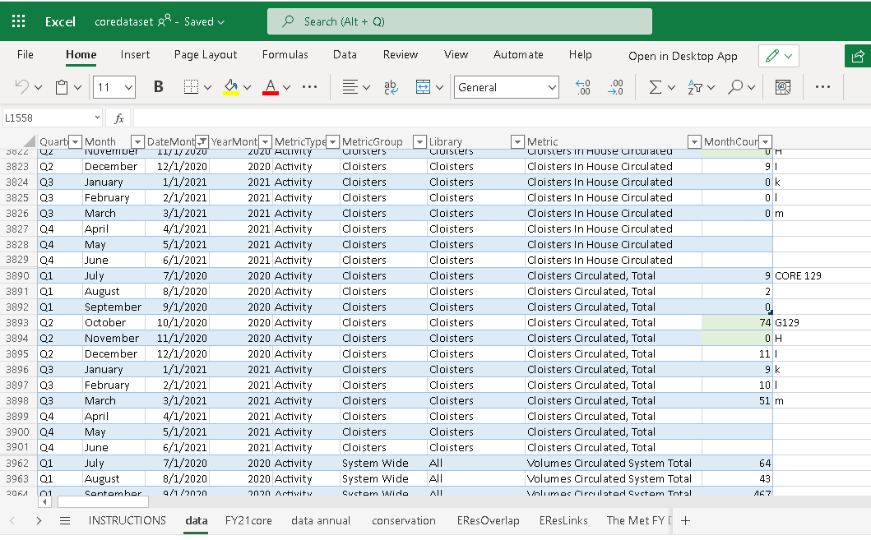
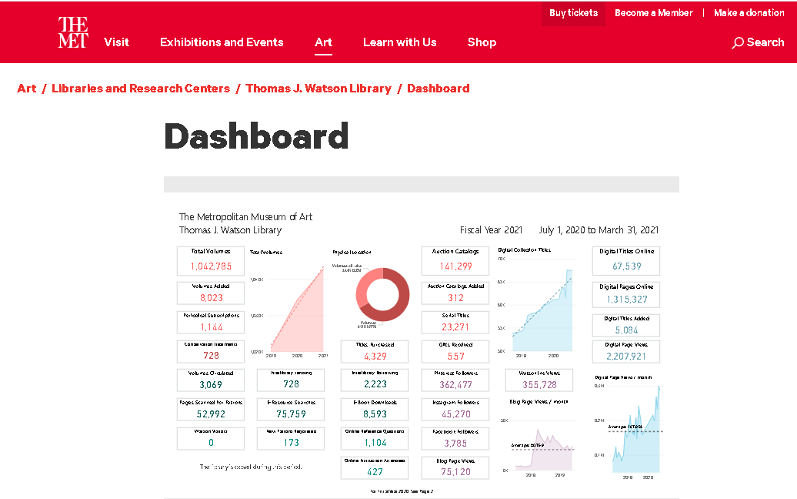
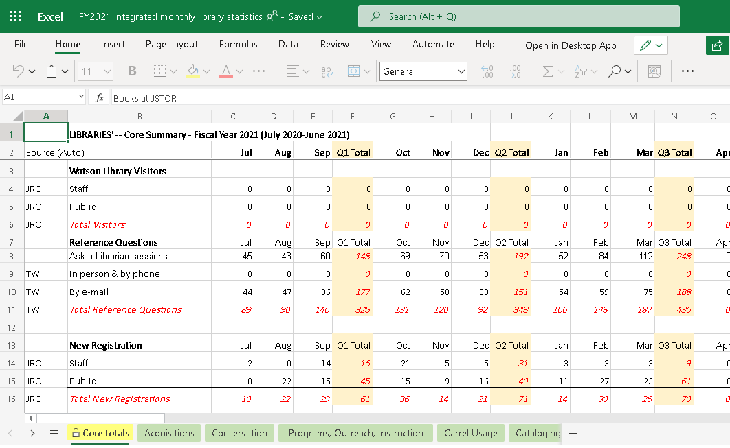
It’s Automatic!
1. Linked Excel sheets on One Drive 2. Scheduled Report Data Refresh 3. Automatic Publish to Web
Published Report embedded in a page on the Met web site.
Master Sheet Linked with scheduled refresh
Report on PowerBI web Service
OneDrive
Notes:
Although data entry into the first Excel sheet is manual, we like the fact that the rest of the workflow which involves refreshing the report and publishing updates to the web
is automated by the PowerBI web service. OneDrive is the Microsoft cloud-based storage service.

Slide 16
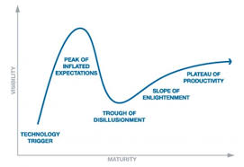
Technology Hype Cycle / Adoption
Peak of Inflated Expectations
Plateau of Productivity
Visibility
Slope of Enlightenment
Trough of Disillusionment
Trigger
TIME
Maturity
Notes:
Another Gartner Group invention is their “Technology Hype Cycle”. We like to say that the stages of the hype cycle are applicable to the learning curve of adopting new technology.
We went through these stages adopting and learning the software … until we finally mastered it!

Slide 17
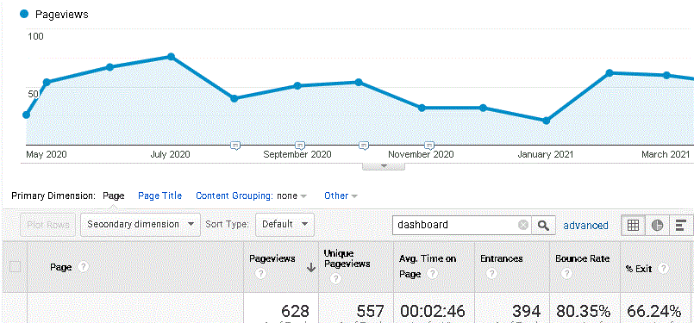
Assessment Visits to the public version of the library dashboard
Source: Google Analytics page views, library dashboard April 2020 – 2021 Staff version viewed an average of 10 times per month.
Notes:
The dashboard has been well received. One assessment is page view for the page displaying the public version of the dashboard.
There was an average around 50 unique views per month; the staff version has about 10 page views per month. The average time on the page was almost three minutes.

Slide 18
EMAIL US QUESTIONS!
William.Blueher@metmuseum.org
Michael.Cummings@metmuseum.org
Notes:
Using PowerBI is quite similar to using Tableau. A demo of data visualization tools including Tableau is provided in the next segment of the panel presentation.

